Slide 1
PDGAN: MRI Image Synthesis for the Diagnosis of Parkinson’s Disease

Slide 2
AI in Diagnostics
Large amount of data perfect for AI
Room for improvement
Millions of lives affected by improvements in this field
Notes:
“AI has a lot of potential in diagnostics since the modern data revolution… each medical device from MRI scanners to Glucose Meters record data to send to a doctor or to store for a patient. AI can capitalize on this information to form predictions.

Slide 3
Background
Parkinson’s Disease is one of the most common neurodegenerative disorders
Despite its prevalence, it’s diagnostic method hasn’t drastically improved in the past 20 years
Accuracy: 80.6%

Slide 4
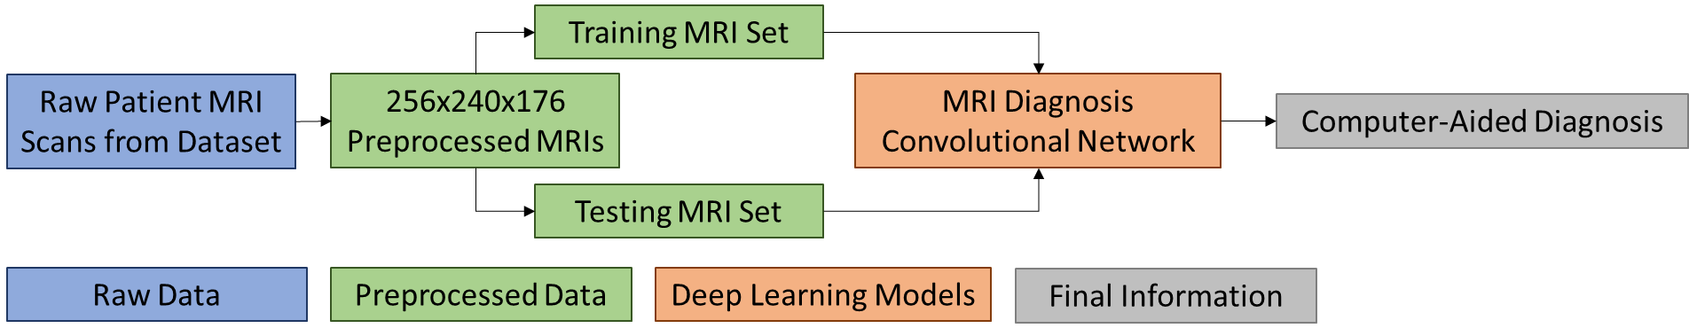
Initial Approach
Root Cause of Parkinson’s → Brain
Analyze MRI scans for signs of early PD
Used USC’s PPMI Project
Hundreds of MRIs from a diverse population
Image analysis used Convolutional Neural Networks

Slide 5
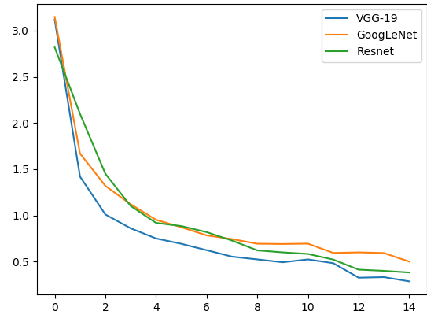
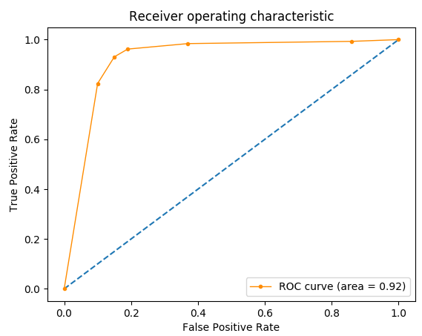
Initial Results
Best model has final accuracy of 90.2%
Higher than clinical accuracy, but improvements could be made.

Slide 6
Can We Do Better?
2

Slide 7
Problems with Initial Attempts
Lack of available data
Hundreds, instead of thousands, of samples
“Off-the-shelf” classification models
Initially used 3D-adapted VGG19, GoogleNet, Resnet for classification

Slide 8
Generative Adversarial Networks
GANs are a flavor of generative networks
Adversarial – comprise of two different networks
Has a variety of applications in different fields

Slide 9
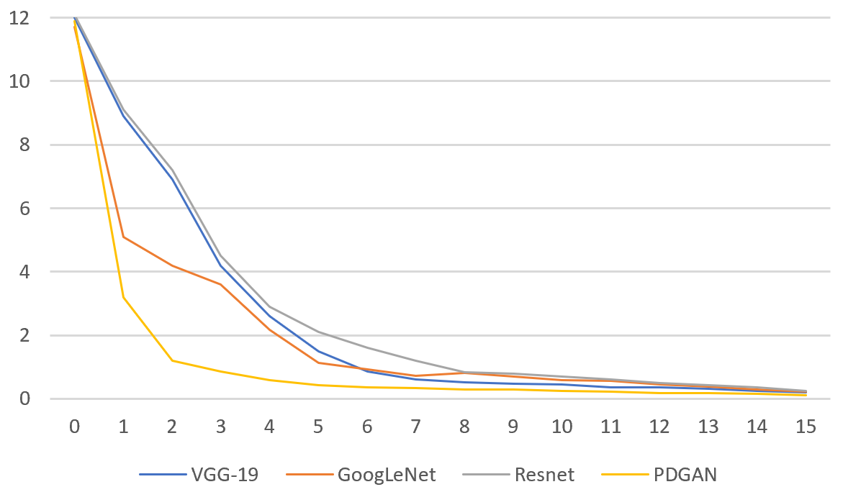
Updated Results
With the generated image, all of the “off-the-shelf” models improved accuracy.
The testing set was completely real images
Some models looked for different features
Model | Accuracy | Sensitivity | Specificity
VGG-19 | 89.29% | 91.32% | 85.24%
VGG-19 | 94.12% | 94.83% | 91.89%
GoogLeNet | 84.97% | 86.21% | 81.08%
GoogLeNet | 91.50% | 92.24% | 89.19%
Resnet-50 | 88.89% | 92.24% | 78.38%
Resnet-50 | 89.54% | 87.93% | 94.59%

Slide 10
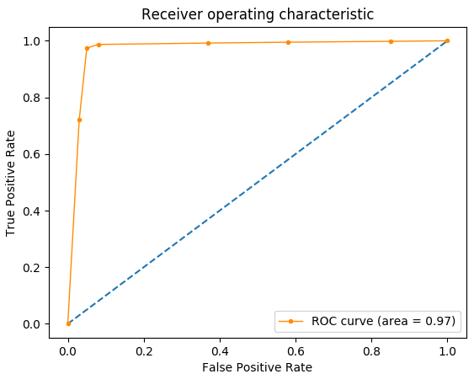
Overall Results
The Compiled Model attained an average accuracy of 96.62% over 8 folds
Sensitivity: 97.41%, Specificity: 94.59%
16% Higher than current clinical diagnosis

Slide 11
AI in Diagnostics
Will it Replace Doctors?
Loss of Jobs?
How can we justify outputs?
Trust among patients?
How can we scale this?
What should be prioritized?
What happens if the AI is wrong?

Slide 12
PDGAN’s Contributions
Creating an early detection system for PD
Provisionally Patented
Talking with Michael J Fox Foundation
Backend for sharable system complete
Applications to other Diseases
Data Augmentation problem solved

